Slide 1
L&D 2 Flow Rate Analysis

Slide 2
Background Information
Github (for history of progress) https://github.com/annahollandkeener/L-D2/commits/main
Flow data acquired from
  L&D 1
    https://waterdata.usgs.gov/nwis/dvstat?referred_module=sw&search_site_no=02105769&format=sites_selection_links
  L&D 3
    https://waterdata.usgs.gov/nwis/dvstat?referred_module=sw&search_site_no=02105500&format=sites_selection_links

Slide 3
Background Information
All of these graphics were created using a python ipynb file, which could be modified to make this process easily repeatable with a variety of stream flow/gauge data sources
  This analysis was also a practice in exploring automation with python
The original data source for this analysis consists of the average daily flow rate, averaged with the same day across 10 years from 2013 – 2023
The earliest data for some of the days starts at 2014, meaning the averages for those days may be slightly skewed

Slide 4
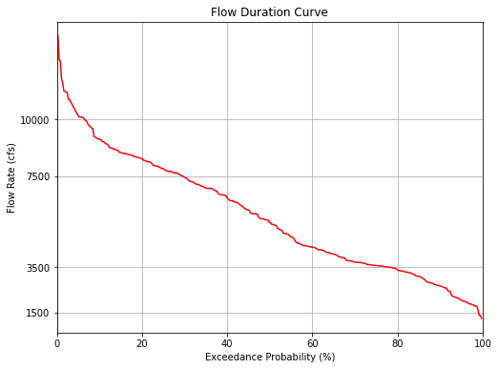
Flow Duration Curve LD2
Created by sorting daily flows in descending order and calculating probabilities for each flow

Slide 5
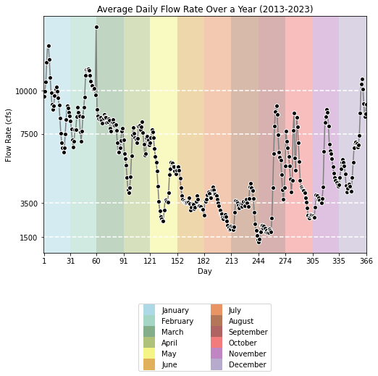
Flow rate of all days over the course of a year, averaged between data from 2013-2023
Flow rates for LD2 were calculated using a weighted average between LD1 and LD3 based on their drainage basin area in square feet

Slide 6
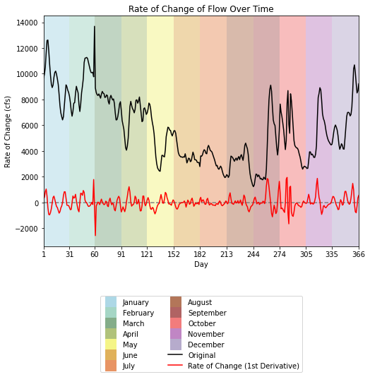
First Derivative of Average Flow

Slide 7
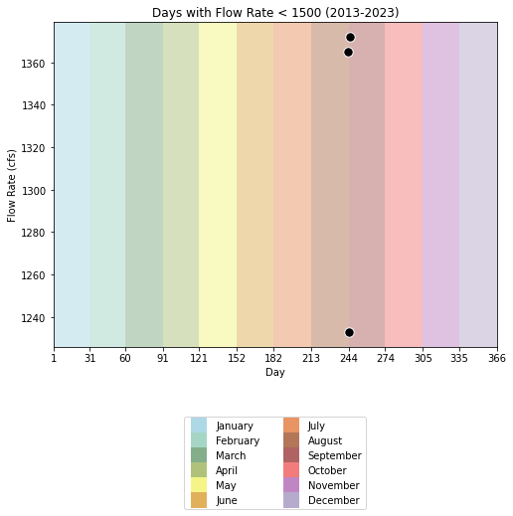
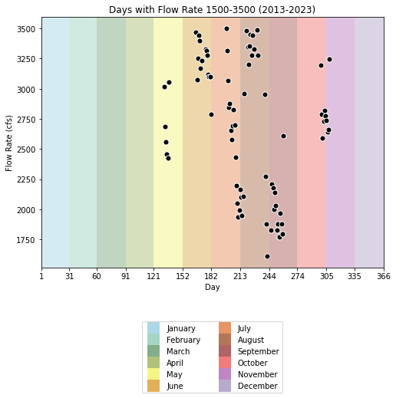

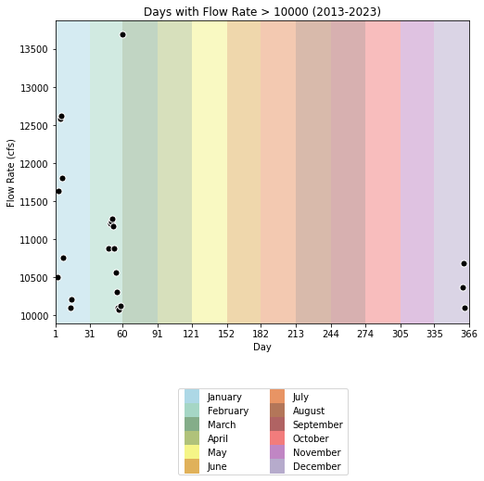
Each day throughout the year (Day 1 – 366) that falls within its respective flow range
Ranges from 1-366 due to the inclusion of leap day

Slide 8
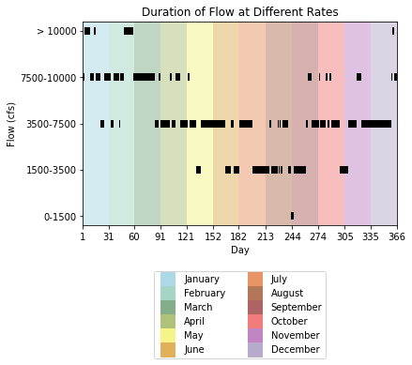
Solid blocks represent periods of consecutive days at specified flow range

Slide 9
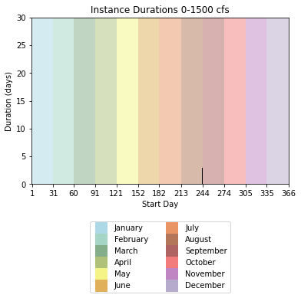
Each bar represents a period of time (multiple consecutive days) at the specified flow range
Range 0-1500 cfs
Day Start | Duration (day)
243.0 | 3.0

Slide 10

Range 1500-3500 cfs
Day Start | Duration (day)
132.0 | 6.0
166.0 | 7.0
176.0 | 7.0
198.0 | 20.0
220.0 | 7.0
228.0 | 1.0
231.0 | 2.0
239.0 | 4.0
246.0 | 14.0
299.0 | 10.0

Slide 11

Range 3500-7500 cfs
Day Start | Duration
21.0 | 5.0
33.0 | 3.0
43.0 | 1.0
84.0 | 5.0
91.0 | 11.0
104.0 | 4.0
114.0 | 9.0
125.0 | 7.0
138.0 | 28.0
173.0 | 3.0
183.0 | 15.0
218.0 | 2.0
227.0 | 1.0
229.0 | 2.0
233.0 | 6.0
260.0 | 2.0
266.0 | 9.0
276.0 | 7.0
285.0 | 2.0
289.0 | 10.0
309.0 | 10.0
324.0 | 35.0

Slide 12

Range 7500-10000 cfs
Day Start | Duration (day)
1.0 | 2.0
9.0 | 5.0
16.0 | 5.0
26.0 | 7.0
36.0 | 7.0
44.0 | 4.0
59.0 | 1.0
61.0 | 23.0
89.0 | 2.0
102.0 | 2.0
108.0 | 6.0
123.0 | 2.0
262.0 | 4.0
275.0 | 1.0
283.0 | 2.0
287.0 | 2.0
319.0 | 5.0
359.0 | 1.0
363.0 | 4.0

Slide 13

Range > 10000
Day Start | Duration (day)
3.0 | 6.0
14.0 | 2.0
48.0 | 11.0
60.0 | 1.0
360.0 | 3.0

